Slide 1
Introduction to Quantum Algorithms
CS.49900 (Spring 2026)
n-qubit quantum states, measurements, unitaries

Slide 2
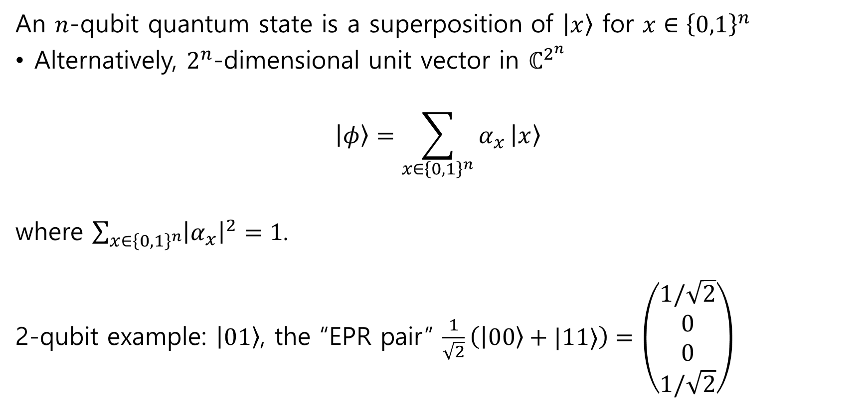
n-qubit quantum state
An $n$-qubit quantum state is a superposition of $\left|x\right\rangle$ for $x∈{\left\{0,1\right\}}^{n}$
Alternatively, $2^{n}$-dimensional unit vector in $ℂ^{2^{n}}$
$$\left|φ\right\rangle =\sum_{x∈{\left\{0,1\right\}}^{n}}{α_{x}}\left|x\right\rangle$$
where $\sum_{x∈{\left\{0,1\right\}}^{n}}{{\left|α_{x}\right|}^{2}}=1$.
2-qubit example: $\left|01\right\rangle$, the “EPR pair” $\frac{1}{\sqrt{2}}\left(\left|00\right\rangle +|11⟩\right)=\left(\begin{aligned}1/\sqrt{2} \\ 0 \\ 0 \\ 1/\sqrt{2}\end{aligned}\right)$

Slide 3
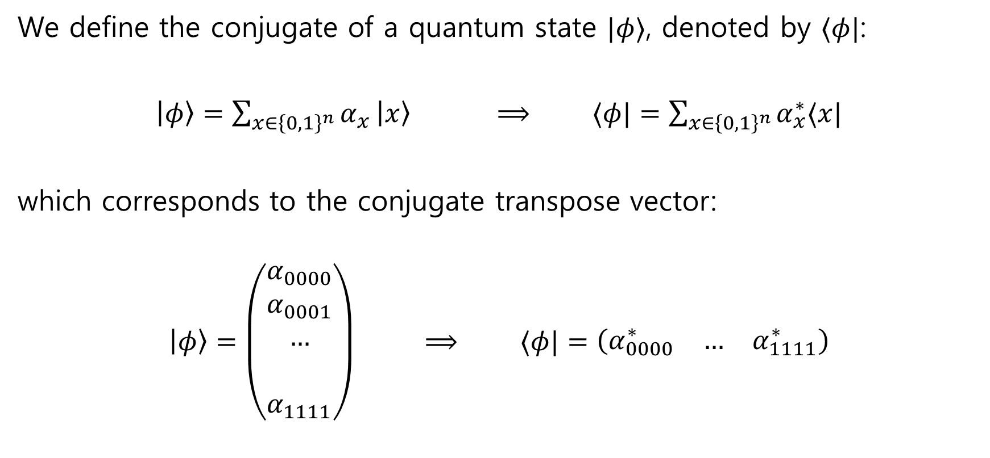
Dual vector: “bra”
We define the conjugate of a quantum state $|φ⟩$, denoted by $⟨φ|$:
$\left|φ\right\rangle =\sum_{x∈{\left\{0,1\right\}}^{n}}{α_{x}}\left|x\right\rangle$ $⟹$ $⟨φ|=\sum_{x∈{\left\{0,1\right\}}^{n}}{α_{x}^{∗}⟨x|}$
which corresponds to the conjugate transpose vector:
$\left|φ\right\rangle =\left(\begin{aligned}α_{0000} \\ α_{0001} \\ … \\ \\ α_{1111}\end{aligned}\right)$ $⟹$ $⟨φ|=\left(\begin{matrix}α_{0000}^{∗} & … & α_{1111}^{∗}\end{matrix}\right)$

Slide 4

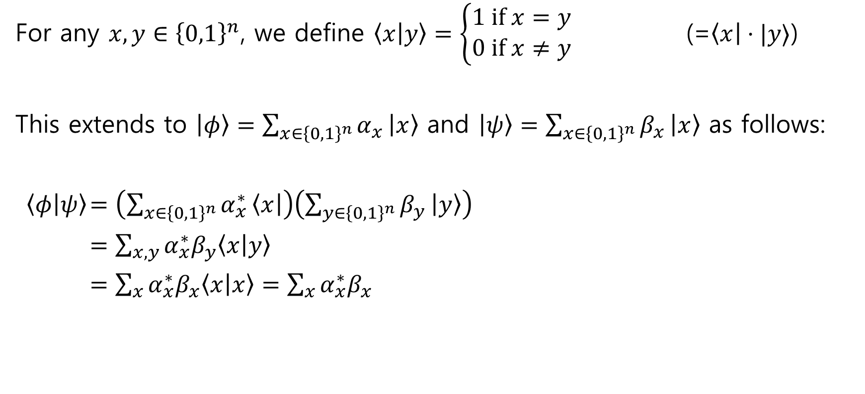
Bra-ket notation = Inner product
For any $x,y∈{\left\{0,1\right\}}^{n}$, we define $\left\langle x | y\right\rangle =\left\{\begin{aligned}1 if x=y \\ 0 if x≠y\end{aligned}\right.$ (=$\left\langle x\right|⋅|y⟩$)
This extends to $\left|φ\right\rangle =\sum_{x∈{\left\{0,1\right\}}^{n}}{α_{x}}\left|x\right\rangle$ and $\left|ψ\right\rangle =\sum_{x∈{\left\{0,1\right\}}^{n}}{β_{x}}\left|x\right\rangle$ as follows:
$\left\langle φ | ψ\right\rangle$ $=\left(\sum_{x∈{\left\{0,1\right\}}^{n}}{α_{x}^{∗}}\left\langle x\right|\right)\left(\sum_{y∈{\left\{0,1\right\}}^{n}}{β_{y}}\left|y\right\rangle \right)$
$=\sum_{x,y}{α_{x}^{∗}β_{y}\left\langle x | y\right\rangle }$
$=\sum_{x}{α_{x}^{∗}β_{x}\left\langle x | x\right\rangle }=\sum_{x}{α_{x}^{∗}β_{x}}$
Sometimes write $\left\langle φ | ψ\right\rangle =\left\langle φ\right|⋅\left|ψ\right\rangle =\left\langle φ\right||ψ⟩$

Slide 5

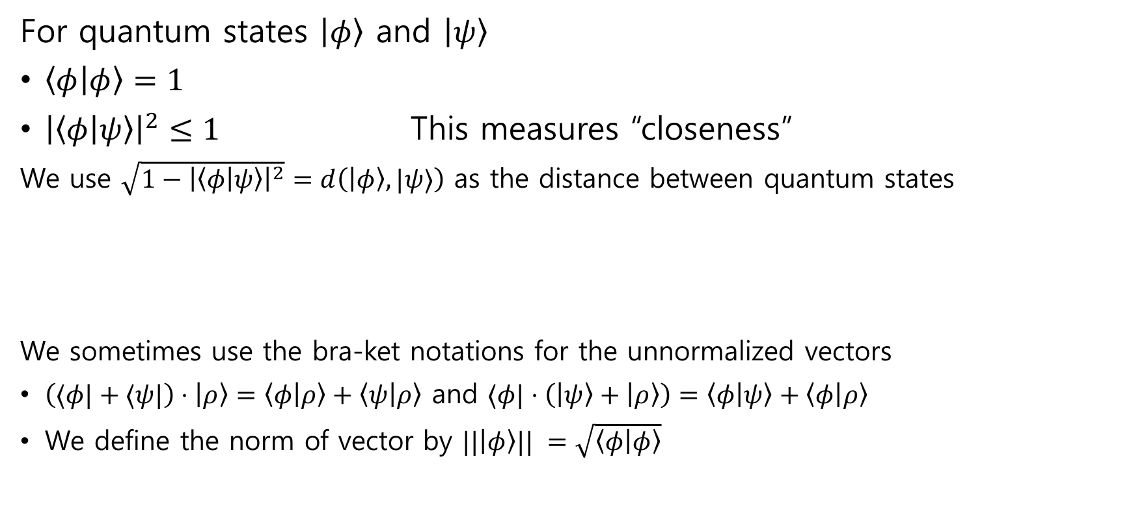
Inner product & extension
For quantum states $\left|φ\right\rangle$ and $\left|ψ\right\rangle$
$\left\langle φ | φ\right\rangle =1$
${\left|\left\langle φ | ψ\right\rangle \right|}^{2}≤1$ This measures “closeness”
We use $\sqrt{1−{\left|\left\langle φ | ψ\right\rangle \right|}^{2}}=d\left(\left|φ\right\rangle ,|ψ⟩\right)$ as the distance between quantum states
We sometimes use the bra-ket notations for the unnormalized vectors
$\left(⟨φ|+⟨ψ|\right)⋅\left|ρ\right\rangle =\left\langle φ | ρ\right\rangle +\left\langle ψ | ρ\right\rangle$ and $⟨φ|⋅\left(\left|ψ\right\rangle +\left|ρ\right\rangle \right)=\left\langle φ | ψ\right\rangle +\left\langle φ | ρ\right\rangle$
We define the norm of vector by $||\left|φ\right\rangle || =\sqrt{\left\langle φ | φ\right\rangle }$
… and $\left|\left\langle φ\right|⋅α|φ⟩ \right|=1$ for any $\left|α\right|=1$
Every states are normalized unless clearly noted

Slide 6
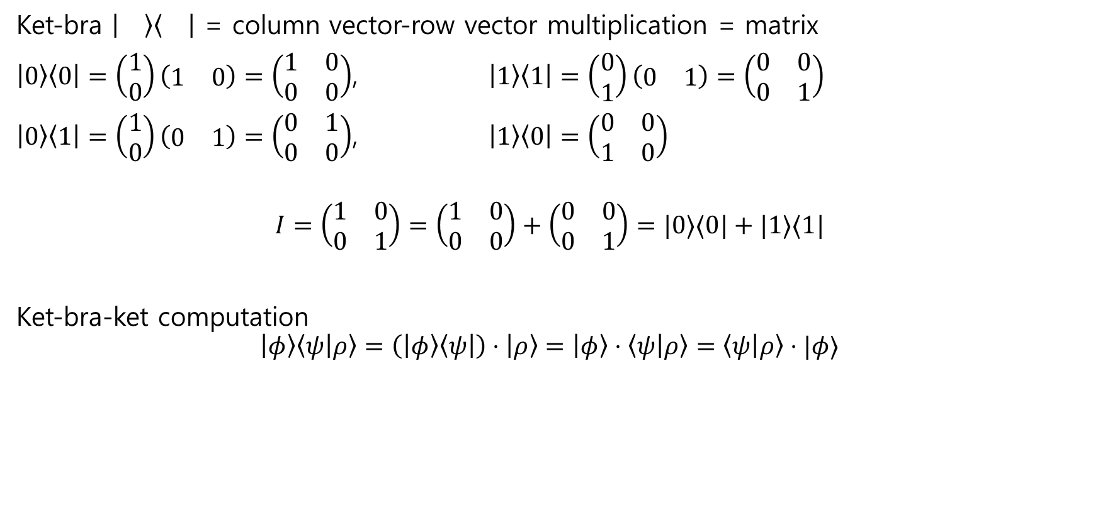
Ket-bra notation = matrix
Ket-bra = column vector-row vector multiplication = matrix
$\left|0\right\rangle \left\langle 0\right|=\left(\begin{aligned}1 \\ 0\end{aligned}\right)\left(\begin{matrix}1 & 0\end{matrix}\right)=\left(\begin{matrix}1 & 0 \\ 0 & 0\end{matrix}\right)$, $\left|1\right\rangle \left\langle 1\right|=\left(\begin{aligned}0 \\ 1\end{aligned}\right)\left(\begin{matrix}0 & 1\end{matrix}\right)=\left(\begin{matrix}0 & 0 \\ 0 & 1\end{matrix}\right)$
$\left|0\right\rangle \left\langle 1\right|=\left(\begin{aligned}1 \\ 0\end{aligned}\right)\left(\begin{matrix}0 & 1\end{matrix}\right)=\left(\begin{matrix}0 & 1 \\ 0 & 0\end{matrix}\right)$, $\left|1\right\rangle \left\langle 0\right|=\left(\begin{matrix}0 & 0 \\ 1 & 0\end{matrix}\right)$
$$I=\left(\begin{matrix}1 & 0 \\ 0 & 1\end{matrix}\right)=\left(\begin{matrix}1 & 0 \\ 0 & 0\end{matrix}\right)+\left(\begin{matrix}0 & 0 \\ 0 & 1\end{matrix}\right)=|0⟩⟨0|+|1⟩⟨1|$$
Ket-bra-ket computation
$$\left|φ\right\rangle \left\langle ψ | ρ\right\rangle =\left(\left|φ\right\rangle \left\langle ψ\right|\right)⋅\left|ρ\right\rangle =\left|φ\right\rangle ⋅\left\langle ψ | ρ\right\rangle =\left\langle ψ | ρ\right\rangle ⋅|φ⟩$$

Slide 7
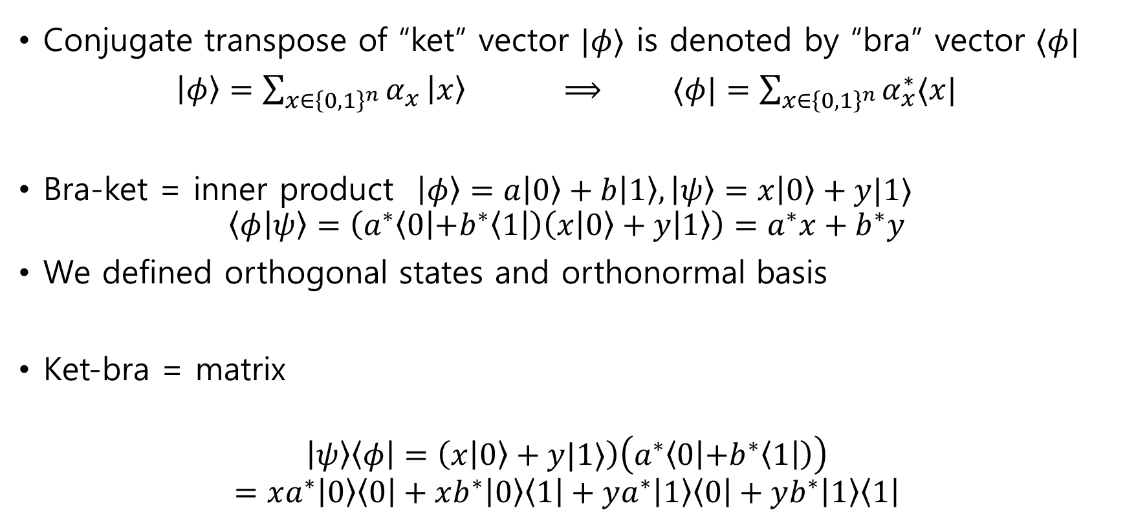
Bra-ket notation summary
Conjugate transpose of “ket” vector $|φ⟩$ is denoted by “bra” vector $⟨φ|$
$\left|φ\right\rangle =\sum_{x∈{\left\{0,1\right\}}^{n}}{α_{x}}\left|x\right\rangle$ $⟹$ $⟨φ|=\sum_{x∈{\left\{0,1\right\}}^{n}}{α_{x}^{∗}⟨x|}$
Bra-ket = inner product $\left|φ\right\rangle =a\left|0\right\rangle +b\left|1\right\rangle ,\left|ψ\right\rangle =x\left|0\right\rangle +y|1⟩$
$$\left\langle φ | ψ\right\rangle =\left(a^{∗}\left\langle 0 | +b^{∗}\left\langle 1\right|\right)\left(x\left|0\right\rangle +y | 1\right\rangle \right)=a^{∗}x+b^{∗}y$$
We defined orthogonal states and orthonormal basis
Ket-bra = matrix
$$\left|ψ\right\rangle \left\langle φ\right|=\left(x\left|0\right\rangle +y|1⟩\right)\left(a^{∗}\left\langle 0 | +b^{∗}\left\langle 1\right|\right)\right)$$
$$=xa^{∗}\left|0\right\rangle \left\langle 0\right|+xb^{∗}\left|0\right\rangle \left\langle 1\right|+ya^{∗}\left|1\right\rangle \left\langle 0\right|+yb^{∗}\left|1\right\rangle \left\langle 1\right|$$

Slide 8

Computations with bra-ket notations
$$I=\left(\begin{matrix}1 & 0 \\ 0 & 1\end{matrix}\right)=\left(\begin{matrix}1 & 0 \\ 0 & 0\end{matrix}\right)+\left(\begin{matrix}0 & 0 \\ 0 & 1\end{matrix}\right)=|0⟩⟨0|+|1⟩⟨1|$$
$$X=\left(\begin{matrix} & 1 \\ 1 & \end{matrix}\right)=\left(\begin{matrix} & \\ 1 & \end{matrix}\right)+\left(\begin{matrix} & 1 \\ & \end{matrix}\right)=|1⟩⟨0|+|0⟩⟨1|$$
$$Z=\left(\begin{matrix}1 & \\ & −1\end{matrix}\right)=\left(\begin{matrix}1 & \\ & \end{matrix}\right)−\left(\begin{matrix} & \\ & −1\end{matrix}\right)=|0⟩⟨0|−|1⟩⟨1|$$
$$X\left|0\right\rangle =\text{(}\text{do} \text{on} \text{board}\text{)}=|1⟩$$
$Z(α\left|0\right\rangle +β|1⟩)=$ (do on board)

Slide 9

Examples
Recall Hadamard matrix $H=\frac{1}{\sqrt{2}}\left(\begin{matrix}1 & 1 \\ 1 & −1\end{matrix}\right)$
$$H=|+⟩⟨0|+|−⟩⟨1|$$
$$H=|0⟩⟨+|+|1⟩⟨−|$$
(Do computations on board)

Slide 10
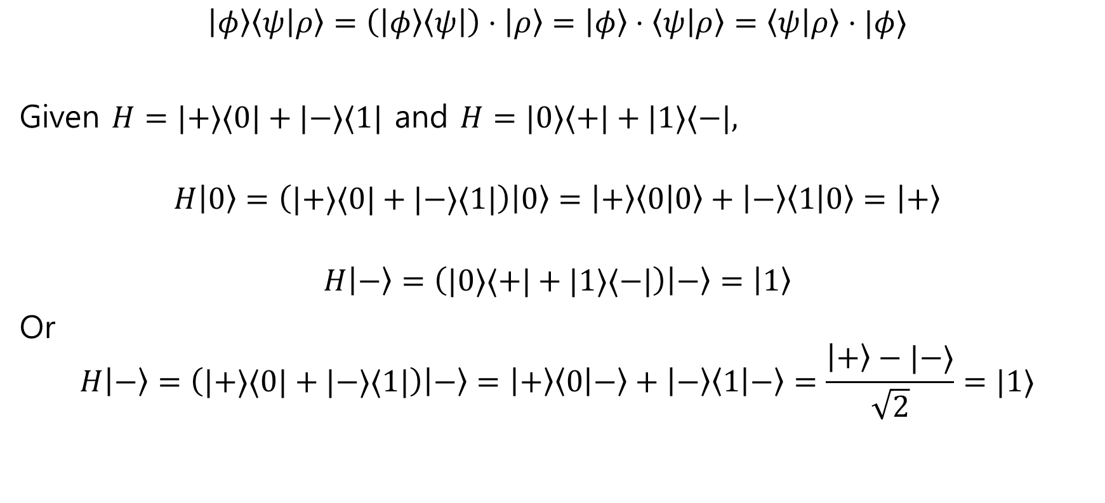
Further computation with bra-ket
$$\left|φ\right\rangle \left\langle ψ | ρ\right\rangle =\left(\left|φ\right\rangle \left\langle ψ\right|\right)⋅\left|ρ\right\rangle =\left|φ\right\rangle ⋅\left\langle ψ | ρ\right\rangle =\left\langle ψ | ρ\right\rangle ⋅|φ⟩$$
Given $H=|+⟩⟨0|+|−⟩⟨1|$ and $H=|0⟩⟨+|+|1⟩⟨−|,$
$$H\left|0\right\rangle =\left(|+⟩⟨0|+|−⟩⟨1|\right)\left|0\right\rangle =\left|+\right\rangle \left\langle 0 | 0\right\rangle +\left|−\right\rangle \left\langle 1 | 0\right\rangle =\left|+\right\rangle$$
$$H\left|−\right\rangle =\left(|0⟩⟨+|+|1⟩⟨−|\right)\left|−\right\rangle =\left|1\right\rangle$$
Or
$$H\left|−\right\rangle =\left(|+⟩⟨0|+|−⟩⟨1|\right)\left|−\right\rangle =\left|+\right\rangle \left\langle 0 | −\right\rangle +\left|−\right\rangle \left\langle 1 | −\right\rangle =\frac{\left|+\right\rangle −|−⟩}{\sqrt{2}}=|1⟩$$

Slide 11
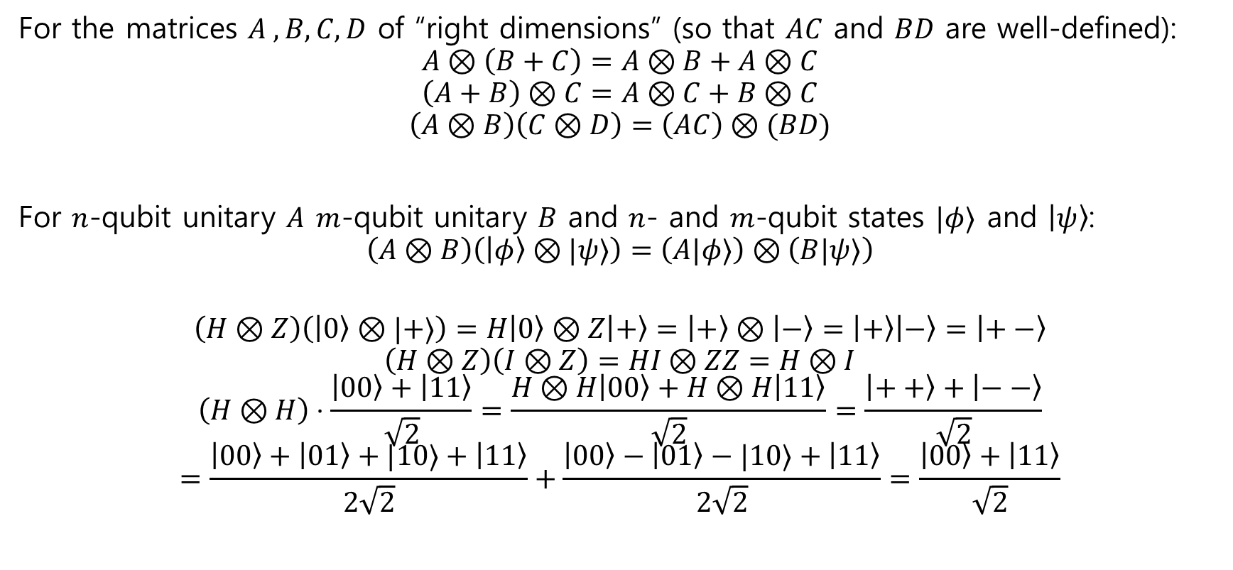
Tensor product properties
For the matrices $A ,B,C,D$ of “right dimensions” (so that $AC$ and $BD$ are well-defined):
$$A⊗\left(B+C\right)=A⊗B+A⊗C$$
$$\left(A+B\right)⊗C=A⊗C+B⊗C$$
$$\left(A⊗B\right)\left(C⊗D\right)=\left(AC\right)⊗(BD)$$
For $n$-qubit unitary $A$ $m$-qubit unitary $B$ and $n$- and $m$-qubit states $|φ⟩$ and $\left|ψ\right\rangle$:
$$\left(A⊗B\right)\left(\left|φ\right\rangle ⊗|ψ⟩\right)=\left(A|φ⟩\right)⊗\left(B|ψ⟩\right)$$
$$\left(H⊗Z\right)\left(\left|0\right\rangle ⊗|+⟩\right)=H\left|0\right\rangle ⊗Z\left|+\right\rangle =\left|+\right\rangle ⊗\left|−\right\rangle =\left|+\right\rangle \left|−\right\rangle =\left|+−\right\rangle$$
$$\left(H⊗Z\right)\left(I⊗Z\right)=HI⊗ZZ=H⊗I$$
$$\left(H⊗H\right)⋅\frac{\left|00\right\rangle +\left|11\right\rangle }{\sqrt{2}}=\frac{H⊗H\left|00\right\rangle +H⊗H\left|11\right\rangle }{\sqrt{2}}=\frac{\left|++\right\rangle +\left|−−\right\rangle }{\sqrt{2}}$$
$$=\frac{\left|00\right\rangle +\left|01\right\rangle +|10⟩+\left|11\right\rangle }{2\sqrt{2}}+\frac{\left|00\right\rangle −\left|01\right\rangle −|10⟩+\left|11\right\rangle }{2\sqrt{2}}=\frac{\left|00\right\rangle +\left|11\right\rangle }{\sqrt{2}}$$

Slide 12

Example
$$\left(H⊗Z\right)\left(\left|0\right\rangle ⊗|+⟩\right)=?$$
$$\left(H⊗Z\right)\left(I⊗Z\right)=?$$
$$\left(H⊗H\right)⋅\frac{\left|00\right\rangle +\left|11\right\rangle }{\sqrt{2}}=?$$

Slide 13

Unitary gate
Recall a one-qubit unitary transform $U$ is represented by a 2 by 2 matrix.
The rows of $U$ form an orthonormal basis for $ℂ^{2}$, and the columns form an orthonormal basis for $ℂ^{2}$
The inverse of $U$ is its Hermitian conjugate $U^{∗}$, i.e., $U^{∗}U=UU^{∗}=I$
(New) $U=\left|φ\right\rangle \left\langle 0\right|+|ψ⟩⟨1|$ where $\left|φ\right\rangle ,\left|ψ\right\rangle$ form an orthonormal basis.
Briefly check on board: (1)=(2)=>(3)=>(1)

Slide 14
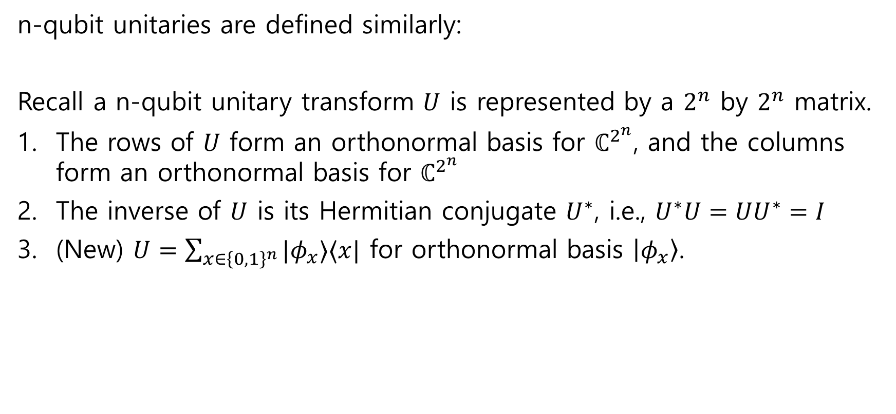
Unitary gate, n-qubit
n-qubit unitaries are defined similarly:
Recall a n-qubit unitary transform $U$ is represented by a $2^{n}$ by $2^{n}$ matrix.
The rows of $U$ form an orthonormal basis for $ℂ^{2^{n}}$, and the columns form an orthonormal basis for $ℂ^{2^{n}}$
The inverse of $U$ is its Hermitian conjugate $U^{∗}$, i.e., $U^{∗}U=UU^{∗}=I$
(New) $U=\sum_{x∈{\left\{0,1\right\}}^{n}}{|φ_{x}⟩⟨x|}$ for orthonormal basis $\left|φ_{x}\right\rangle$.

Slide 15

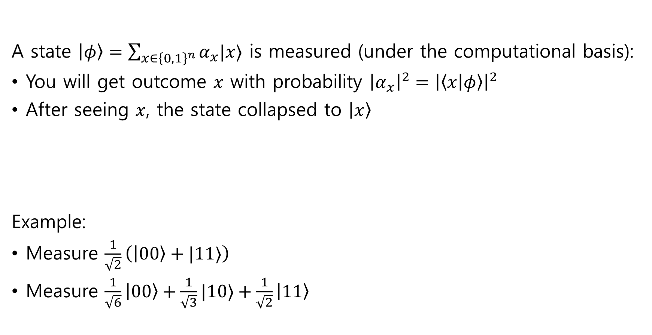

n-qubit computational basis measurement
A state $\left|φ\right\rangle =\sum_{x∈{\left\{0,1\right\}}^{n}}{α_{x}|x⟩}$ is measured (under the computational basis):
You will get outcome $x$ with probability ${\left|α_{x}\right|}^{2}={\left|\left\langle x | φ\right\rangle \right|}^{2}$
After seeing $x$, the state collapsed to $\left|x\right\rangle$
Example:
Measure $\frac{1}{\sqrt{2}}\left(\left|00\right\rangle +|11⟩\right)$
Measure $\frac{1}{\sqrt{6}}\left|00\right\rangle +\frac{1}{\sqrt{3}}|10⟩+\frac{1}{\sqrt{2}}\left|11\right\rangle$
$$\left|φ\right\rangle$$

Slide 16

Partial measurement
What happens if we only measure the first qubit of the system?
What is this?
$$\left|φ\right\rangle$$

Slide 17


Examples
Distribution of the outcome:
$\left|0\right\rangle$ and $\left|1\right\rangle$ with equal probability
Post-measurement state given outcome $\left|b\right\rangle$:
$$\left|b\right\rangle ⊗|−⟩$$
This is “unentangled” state
$$\left|+\right\rangle ⊗|−⟩$$

Slide 18


Examples
Distribution of the outcome:
$\left|0\right\rangle$ and $\left|1\right\rangle$ with equal probability
Post-measurement state given outcome $\left|0\right\rangle$:
$$\left|00\right\rangle$$
Post-measurement state given outcome $\left|1\right\rangle$:
$$|11⟩$$
$$\frac{1}{\sqrt{2}}\left(\left|00\right\rangle +|11⟩\right)$$

Slide 19
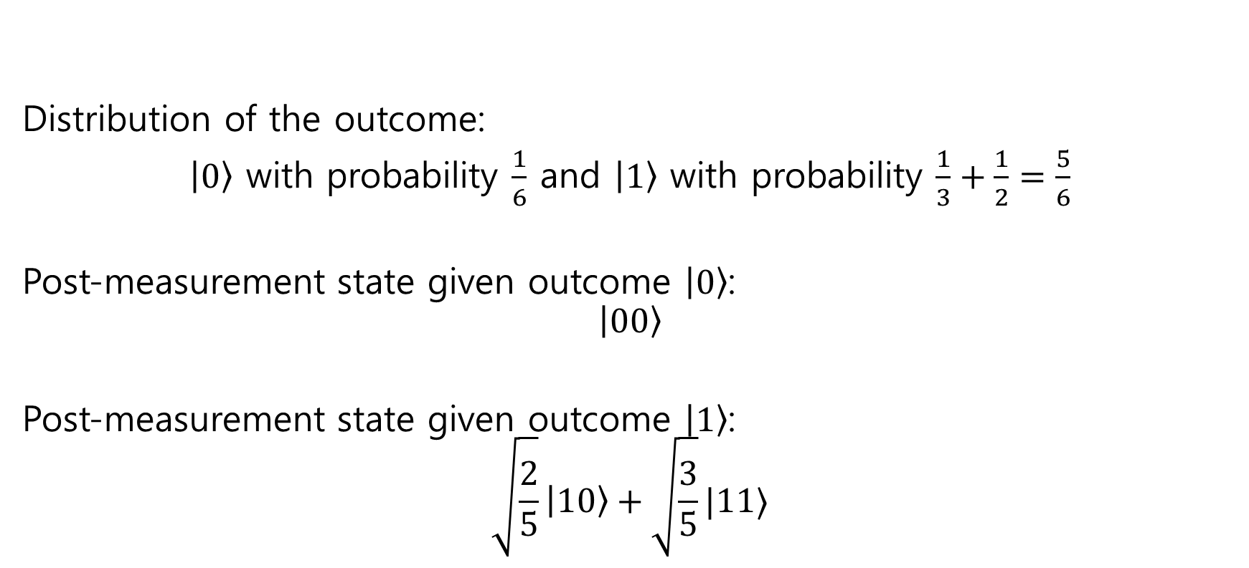
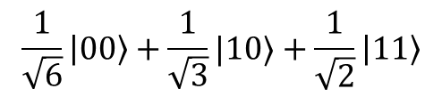
Examples
$$\frac{1}{\sqrt{6}}\left|00\right\rangle +\frac{1}{\sqrt{3}}|10⟩+\frac{1}{\sqrt{2}}\left|11\right\rangle$$
Distribution of the outcome:
$\left|0\right\rangle$ with probability $\frac{1}{6}$ and $\left|1\right\rangle$ with probability $\frac{1}{3}+\frac{1}{2}=\frac{5}{6}$
Post-measurement state given outcome $\left|0\right\rangle$:
$$\left|00\right\rangle$$
Post-measurement state given outcome $\left|1\right\rangle$:
$$\sqrt{\frac{2}{5}}\left|10\right\rangle +\sqrt{\frac{3}{5}}|11⟩$$

Slide 20
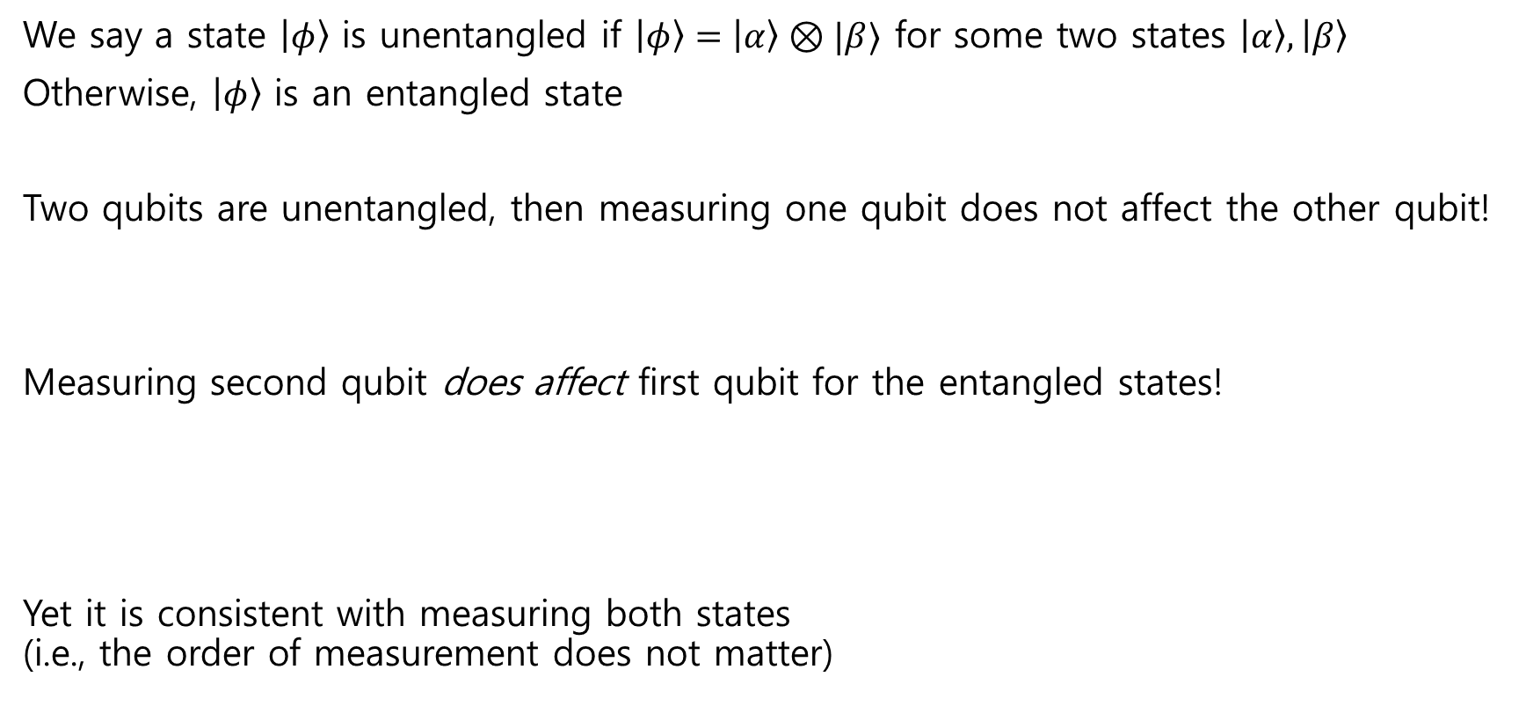

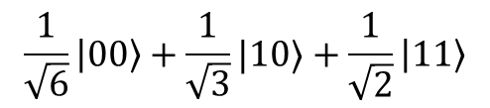
Things to check
We say a state $\left|φ\right\rangle$ is unentangled if $\left|φ\right\rangle =\left|α\right\rangle ⊗|β⟩$ for some two states $\left|α\right\rangle ,\left|β\right\rangle$
Otherwise, $\left|φ\right\rangle$ is an entangled state
Two qubits are unentangled, then measuring one qubit does not affect the other qubit!
Measuring second qubit does affect first qubit for the entangled states!
Yet it is consistent with measuring both states (i.e., the order of measurement does not matter)
$$\frac{1}{\sqrt{6}}\left|00\right\rangle +\frac{1}{\sqrt{3}}|10⟩+\frac{1}{\sqrt{2}}\left|11\right\rangle$$
$$=$$

Slide 21
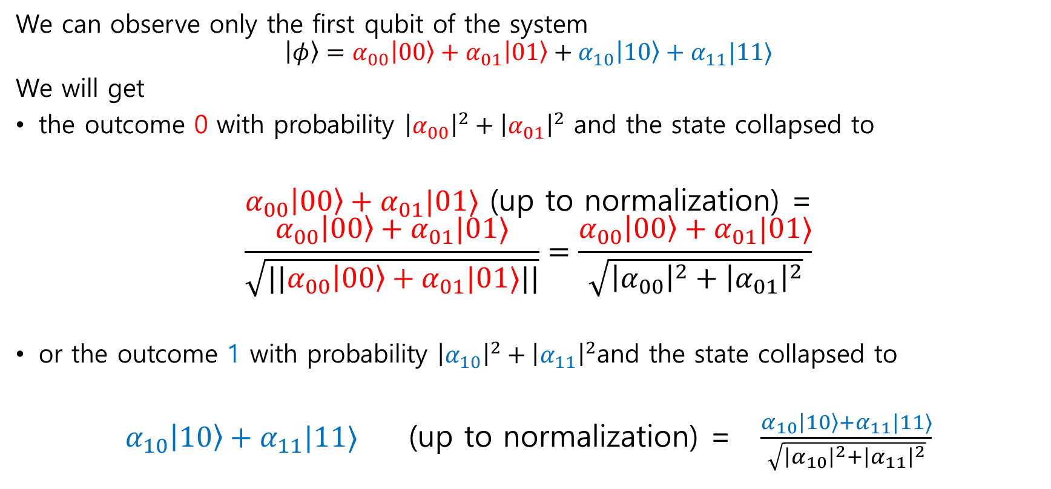
Define partial measurement (2-qubit)
We can observe only the first qubit of the system
$$\left|φ\right\rangle =α_{00}\left|00\right\rangle +α_{01}\left|01\right\rangle +α_{10}\left|10\right\rangle +α_{11}|11⟩$$
We will get
the outcome 0 with probability ${\left|α_{00}\right|}^{2}+{\left|α_{01}\right|}^{2}$ and the state collapsed to
$α_{00}\left|00\right\rangle +α_{01}|01⟩$ (up to normalization) =
$$\frac{α_{00}\left|00\right\rangle +α_{01}|01⟩}{\sqrt{||α_{00}\left|00\right\rangle +α_{01}|01⟩||}}=\frac{α_{00}\left|00\right\rangle +α_{01}|01⟩}{\sqrt{{\left|α_{00}\right|}^{2}+{\left|α_{01}\right|}^{2}}}$$
or the outcome 1 with probability ${\left|α_{10}\right|}^{2}+{\left|α_{11}\right|}^{2}$and the state collapsed to
$α_{10}\left|10\right\rangle +α_{11}|11⟩$ (up to normalization) = $\frac{α_{10}\left|10\right\rangle +α_{11}|11⟩}{\sqrt{{\left|α_{10}\right|}^{2}+{\left|α_{11}\right|}^{2}}}$

Slide 22

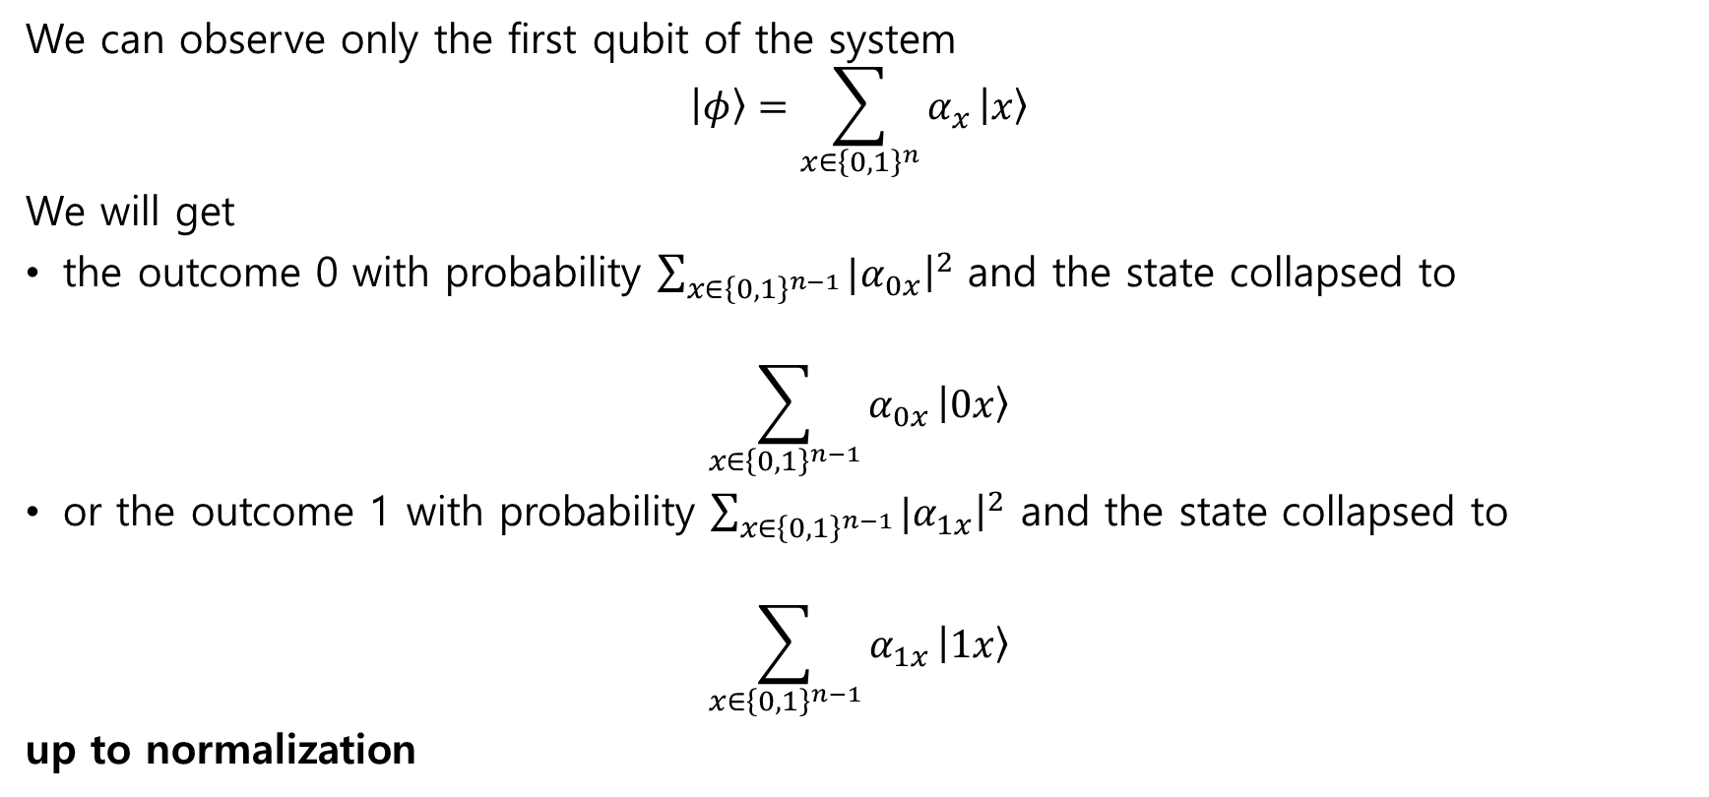
Partial measurement (n-qubit)
We can observe only the first qubit of the system
$$\left|φ\right\rangle =\sum_{x∈{\left\{0,1\right\}}^{n}}{α_{x}}\left|x\right\rangle$$
We will get
the outcome 0 with probability $\sum_{x∈{\left\{0,1\right\}}^{n−1}}{{|α}_{0x}{\left.​\right|}^{2}}$ and the state collapsed to
$$\sum_{x∈{\left\{0,1\right\}}^{n−1}}{α_{0x}}\left|0x\right\rangle$$
or the outcome 1 with probability $\sum_{x∈{\left\{0,1\right\}}^{n−1}}{{|α}_{1x}{\left.​\right|}^{2}}$ and the state collapsed to
$$\sum_{x∈{\left\{0,1\right\}}^{n−1}}{α_{1x}}\left|1x\right\rangle$$
up to normalization
$$\frac{\sum_{x∈{\left\{0,1\right\}}^{n−1}}{α_{0x}}\left|0x\right\rangle }{\sqrt{\sum_{x∈{\left\{0,1\right\}}^{n−1}}{{|α}_{0x}{\left.​\right|}^{2}}}}$$

Slide 23
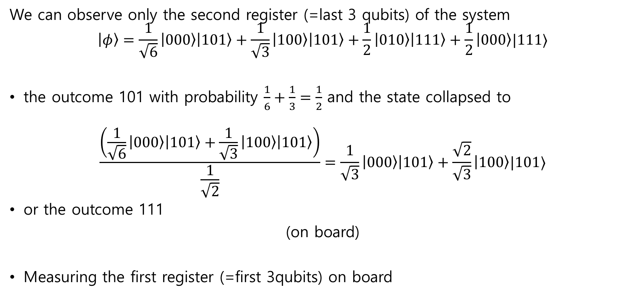
Example
We can observe only the second register (=last 3 qubits) of the system
$$\left|φ\right\rangle =\frac{1}{\sqrt{6}}\left|000\right\rangle \left|101\right\rangle +\frac{1}{\sqrt{3}}\left|100\right\rangle \left|101\right\rangle +\frac{1}{2}\left|010\right\rangle \left|111\right\rangle +\frac{1}{2}\left|000\right\rangle |111⟩$$
the outcome 101 with probability $\frac{1}{6}+\frac{1}{3}=\frac{1}{2}$ and the state collapsed to
$$\frac{\left(\frac{1}{\sqrt{6}}\left|000\right\rangle \left|101\right\rangle +\frac{1}{\sqrt{3}}\left|100\right\rangle \left|101\right\rangle \right)}{\frac{1}{\sqrt{2}}}=\frac{1}{\sqrt{3}}\left|000\right\rangle \left|101\right\rangle +\frac{\sqrt{2}}{\sqrt{3}}\left|100\right\rangle |101⟩$$
or the outcome 111
(on board)
Measuring the first register (=first 3qubits) on board

Slide 24
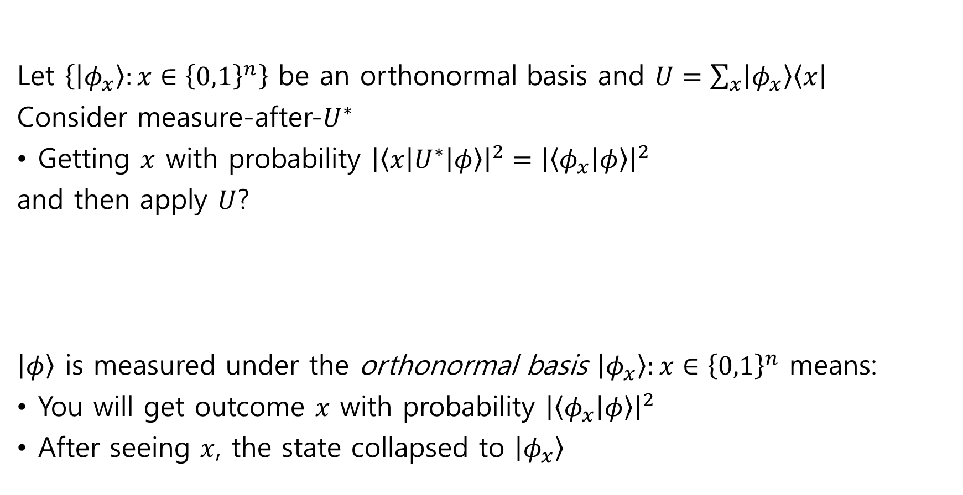



Measure after unitary = General measurement
Let $\left\{\left|φ_{x}\right\rangle :x∈{\left\{0,1\right\}}^{n}\right\}$ be an orthonormal basis and $U=\sum_{x}{\left|φ_{x}\right\rangle \left\langle x\right|}$
Consider measure-after-$U^{∗}$
Getting $x$ with probability ${\left|\left\langle x\left|U^{∗}\right|φ\right\rangle \right|}^{2}={\left|\left\langle φ_{x} | φ\right\rangle \right|}^{2}$
and then apply $U$?
$\left|φ\right\rangle$ is measured under the orthonormal basis $\left|φ_{x}\right\rangle :x∈{\left\{0,1\right\}}^{n}$ means:
You will get outcome $x$ with probability ${\left|\left\langle φ_{x} | φ\right\rangle \right|}^{2}$
After seeing $x$, the state collapsed to $\left|φ_{x}\right\rangle$
$$\left|φ\right\rangle$$
$$U^{∗}$$
$$U$$

Slide 25

Example: High-dimensional Cat state
$$\frac{\left|100\right\rangle +|110⟩}{\sqrt{2}}$$
or just $\frac{\left|a\right\rangle +|b⟩}{\sqrt{2}}=|+_{a,b}⟩$ for $a=100$, $b=110$
Measure under the computational basis?
Measure the first or second qubit?
Measure under the basis $|+_{a,b}⟩$ and $|−_{a,b}⟩$, and $|x⟩$ for $x≠a,b$?

